Slide 1
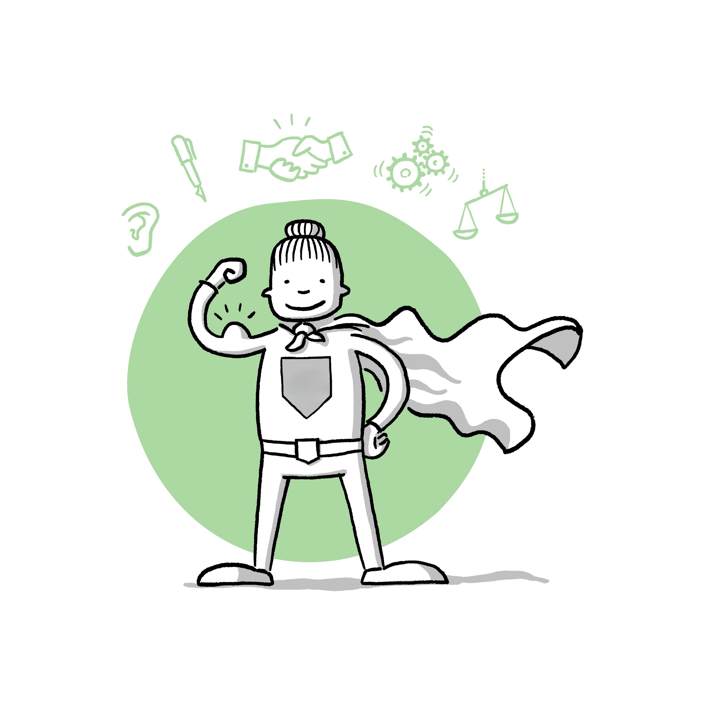
A warm welcome to today's workshop!
Taking responsibility &
being a role model
My role as a leading athlete

Slide 2
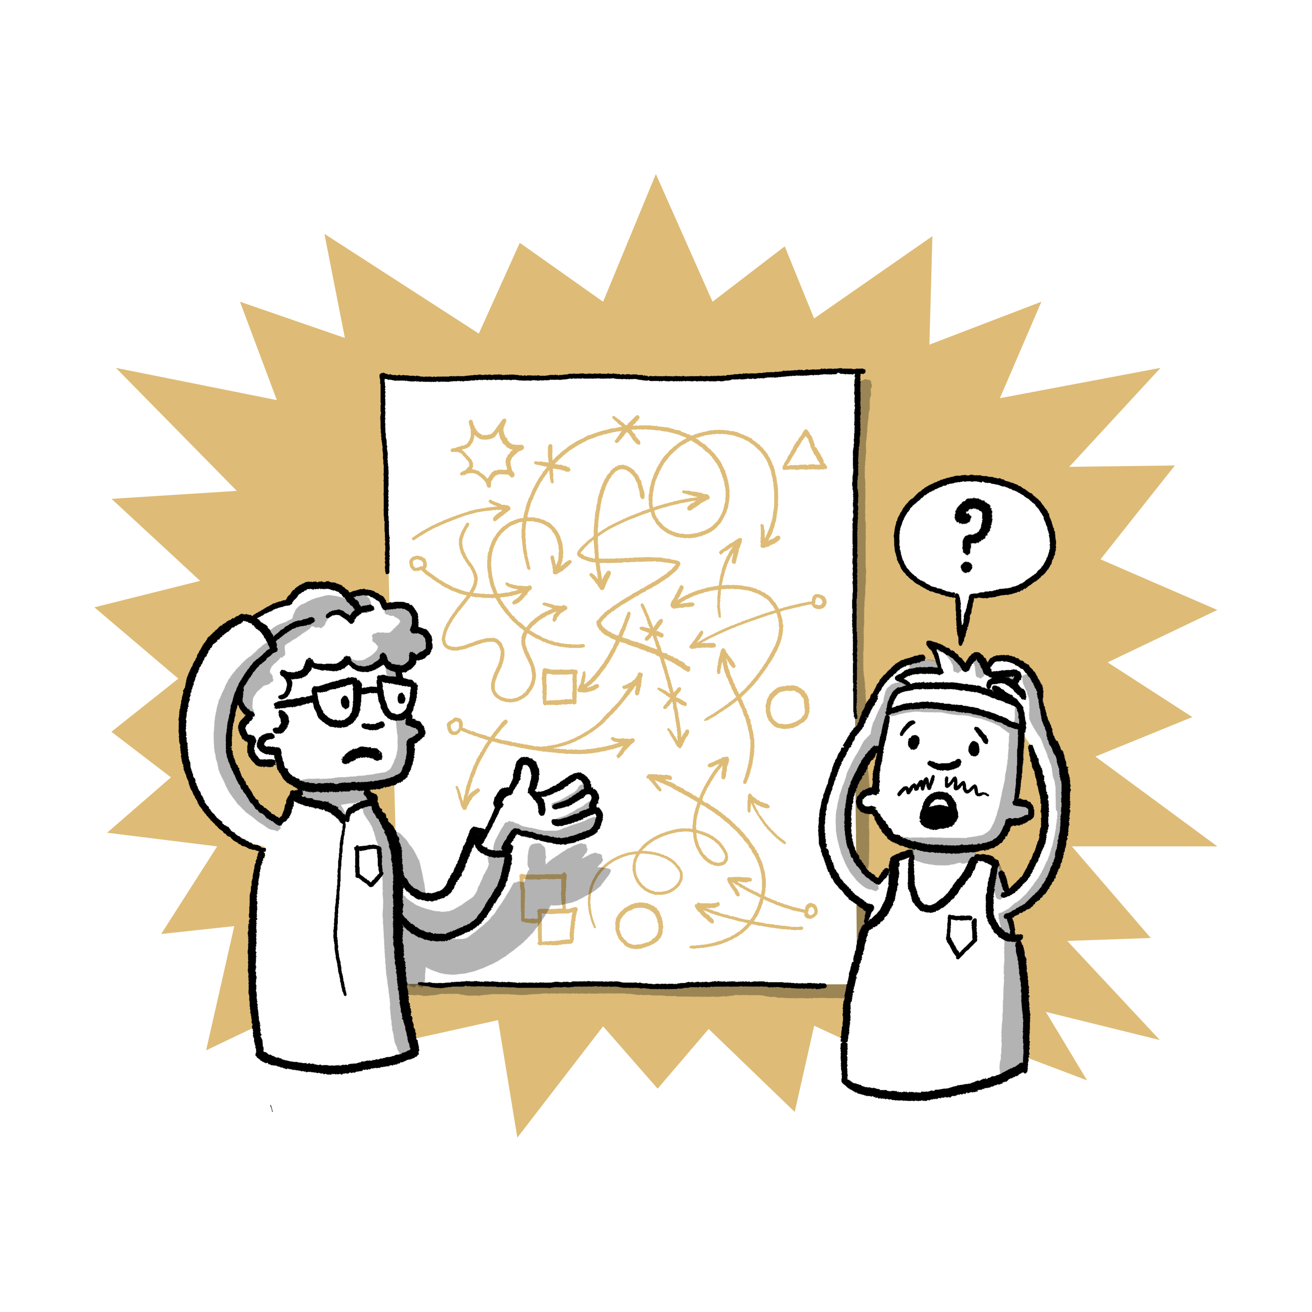
My role in the team

Slide 3
My role in the team
Leadership athletes can take responsibility for the team as a:
Task tracker
Achieving tasks and goals
Motivator
Motivating fellow athletes
Team player
Creating a cohesive and positive atmosphere in the team
Presenter
Representing the team externally and in public

Slide 4

My role in the team
... to support a safe and positive training environment

Slide 5

Who can I contact?
Contact persons in the club
Name local contact points/cooperation partners
Name contact points of the association/state sports association or similar

